Slide 1
GROUP THEORY-BASICS

Slide 2
Basic Group Theory
1 Basic Definitions and Simple Examples
2 Further Examples, Subgroups
3 The Rearrangement Lemma & the Symmetric Group
4 Classes and Invariant Subgroups
5 Cosets and Factor (Quotient) Groups
6 Homomorphisms
7 Direct Products

Slide 3
1 Basic Definitions and Simple Examples
Definition 1: Group
{ G, • } is a group if ∀ a , b , c Î G
1. a • b ÎG ( closure )
2. ( a • b ) • c = a • ( b • c ) ( associativity )
3. $ e Î G ' e • a = a • e = a ( identity )
4. $ a^{–1} Î G ' a^{–1} • a = a • a^{–1} = e ( inverse )
Definition in terms of multiplication table (abstract group):
G | e | a | b | ☹
e | e • e | e • a | e • b | ☹
a | a • e | a • a | a • b | ☹
b | b • e | b • a | b • b | ☹
 |  |  |  | 
e | a | b | ☹
a | a • a | a • b | ☹
b | b • a | b • b | ☹
 |  |  | 

Slide 4
Example 1: C₁
C₁ | e
e | e
Realizations:
{e} = { 1 }
Realizations:
{e,a} = { 1, –1}
Reflection group: C_{σ} = { E, σ }
Rotation group: C₂ = { E, C₂ }
e | a
a | e
Example 2: C₂
C_{n} = Rotation of angle 2π/n
Realizations:
Rotation group: C₃ = { E, C₃ , C₃^{–1} }
Cyclic group: C₃ = { e, a, a² ; a³=e }
{ 1, e ^{i 2π/3}, e ^{i 4π/3} }
Cyclic permutation of 3 objects
{ (123), (231), (312) }
e | a | b
a | b | e
b | e | a
Example 3: C₃
Cyclic group : C_{n} = { e, a, a², a³, … a^{n-1} ; a^{n} = e }

Slide 5
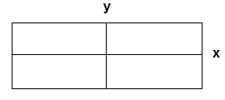
Definition 2: Abelian (commutative) Group
G is Abelian if a b = b a ∀ a,b ∈ G
Common notations:
• → + e → 0
Definition 3: Order
Order g of group G = Number of elements in G
Example 4: Dihedral group D₂
Simplest non-cyclic group is
D₂ = { e, a = a^{–1}, b = b^{–1}, c = a b }
( Abelian, order = 4 )
e | a | b | c
a | e | c | b
b | c | e | a
c | b | a | e
Realizations:
D₂ = { symmetries of a rectangle }
= { E , C₂, σ_{x}, σ_{y} }
= { E, C₂ , C₂' , C₂" }

Slide 6
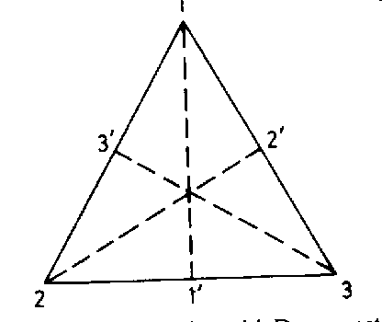
2 Further Examples, Subgroups
The simplest non-Abelian group is of order 6.
{ e, a, b = a^{–1}, c = c^{–1}, d = d^{–1}, f = f^{–1} }
Aliases: Dihedral group D₃, C_{3v}, or permutation group S₃.
e | C₃ | C₃² | σ₁ | σ₂ | σ₃
C₃ | C₃² | e | σ₃ | σ₁ | σ₂
C₃² | e | C₃ | σ₂ | σ₃ | σ₁
σ₁ | σ₂ | σ₃ | e | C₃ | C₃²
σ₂ | σ₃ | σ₁ | C₃² | e | C₃
σ₃ | σ₁ | σ₂ | C₃ | C₃² | e
e | a | b | c | d | f
a | b | e | f | c | d
b | e | a | d | f | c
c | d | f | e | a | b
d | f | c | b | e | a
f | c | d | a | b | e
Symmetries of an equilateral triangle:
C_{3v} = { E, C₃, C₃², σ₁, σ₂, σ₃ }
D₃ = { E, C₃, C₃², C₂', C₂'', C₂''' }

Slide 7
S₃ = { e, (123), (132), (23), (13), (12) }
(…) = cyclic permutations
e | (123) | (132) | (23) | (13) | (12)
(123) | (132) | e | (12) | (23) | (13)
(132) | e | (123) | (13) | (12) | (23)
(23) | (13) | (12) | e | (123) | (132)
(13) | (12) | (23) | (132) | e | (123)
(12) | (23) | (13) | (123) | (132) | e
e | (12) | (23) | (31) | (123) | (321)
(12) | e | (123) | (321) | (23) | (31)
(23) | (321) | e | (123) | (31) | (12)
(31) | (123) | (321) | e | (12) | (23)
(123) | (31) | (12) | (23) | (321) | e
(321) | (23) | (31) | (12) | e | (123)
Tung's notation

Slide 8
Definition 4: Subgroup
{ H ⊆ G, • } is a subgroup of { G , • } .
Example 1: D₂ = { e, a, b, c }
3 subgroups: { e, a }, { e, b } , { e, c }
Example 2: D₃ ≈ S₃ ≈ { e, a, b = a^{–1}, c = c^{–1}, d = d^{–1}, f = f^{–1} }
4 subgroups: { e, a, b } , { e, c }, { e, d }, { e, f }
Infinite Group : Group order = ∞
E.g. T^{d} = { T(n) | n∈Z }
Some subgroups:
Continuous Group : Elements specified by continuous parameters
E.g. Continuous translations T
Continuous rotations R(2), R(3)
Continuous translations & rotations E(2), E(3)

Slide 9
3. The Rearrangement Lemma & the Symmetric Group
Lemma: Rearrangement
p b = p c → b = c where p, b, c ∈ G
Proof: p^{–1} both sides
Corollary: p G = G rearranged; likewise G p
Permutation:
p_{i} ← i ( Active point of view )
Product: p q = ( p_{k} ← k) ( q_{i} ← i )
(Rearranged)

Slide 10
Identity:
Inverse:
i ← p_{i}
Symmetric (Permutation) group S_{n} ≡ { n! permutations of n objects }
n-Cycle = ( p₁, p₂, p₃,…, p_{n} )
Every permutation can be written as a product of cycles

Slide 11
Example

Slide 12
Definition 5: Isomorphism
2 groups G & G ' are isomorphic ( G ≈ G ' ) , if  a 1-1 onto mapping
φ : G → G ' g_{i}   g_{i}' ∋ g_{i} g_{j} = g_{k} ↔ g_{i} g_{j}' = g_{k}'
Examples:
Rotational group C_{n} ≈ cyclic group C_{n}
D₃ ≈ C_{3v} ≈ S₃
Theorem 1: Cayley
Every group of finite order n is isomorphic to a subgroup of S_{n}
Proof: Let G = { g₁, g₂, …, g_{n} } . The required mapping is
φ : G → S_{n}
where
⇒

Slide 13
Example 1: C₃ = { e, a, b = a² ; a³=e } = { g₁, g₂, g₃ }
e | a | b
a | b | e
b | e | a
1 | 2 | 3
2 | 3 | 1
3 | 1 | 2
C₃ ≈ { e, (123), (321) }, subgroup of S₃
Example 2: D₂ = { e, a = a^{–1}, b = b^{–1}, c = a b }
e | a | b | c
a | e | c | b
b | c | e | a
c | b | a | e
1 | 2 | 3 | 4
2 | 1 | 4 | 3
3 | 4 | 1 | 2
4 | 3 | 2 | 1
D₂ ≈ { e, (12)(34), (13)(24), (14)(23) }, subgroup of S₄

Slide 14
Example 3: C₄ = { e = a⁴, a, a², a³ }
e | a | a² | a³
a | a² | a³ | e
a² | a³ | e | a
a³ | e | a | a²
1 | 2 | 3 | 4
2 | 3 | 4 | 1
3 | 4 | 1 | 2
4 | 1 | 2 | 3
D₂ ≈ { e, (1234), (13)(24), (1432) }, subgroup of S₄
Let S be a subgroup of S_{n} that is isomorphic to a group G of order n. Then
The only element in S that contains 1-cycles is e ( else, rearrangement therem is violated )
All cycles in a given element are of the same length ( else, some power of it will contain 1-cycles )
E.g., [ (12)(345) ]² = (1) (2) (345)²
If order of G is prime, then S can contain only full n-cycles, ie, S is cyclic
Only 1 group for each prime order

Slide 15
4. Classes and Invariant Subgroups
Definition 6: Conjugate Elements
Let a , b ∈ G. b is conjugate to a, or b~a, if
 p∈G ∋ b = p a p^{–1}
Example: S₃
(12) ~ (31) since (23) (31) (23)^{–1} = (23) (132) = (12)(3) = (12)
(123) ~ (321) since (12) (321) (12) = (12) (1)(23) = (123)
Exercise: Show that for p, q ∈ S_{n} ,
Hint:

Slide 16
Def: ~ is an equivalence relation if
a ~ a (reflexive)
a~b → b~a  (symmetric)
a~b, b~c → a~c (transitive)
Conjugacy is an equivalence relation
Proof :
(reflexive)
∴
(symmetric)
∴
(transitive)

Slide 17
An equivalence relation partitions (classifies members of) a set.
Definition 7: Conjugate Class
Let a ∈ G, the conjugate class of a is the set ξ = { p a p^{–1} | p ∈ G }
Comments:
Members of a class are equivalent & mutually conjugate
Every group element belongs to 1 & only 1 class
e is always a class by itself
For matrix groups, conjugacy = similarity transform

Slide 18
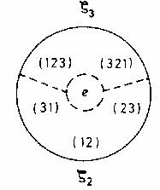
Example 1: S₃ (3 classes):
ξ₁ = { e } identity
ξ₂ = { (12), (23), (31) } 2-cycles
ξ₃ = { (123), (321) } 3-cycles
→ Permutations with the same cycle structure belong to the same class.
Example 2: R(3) (Infinitely many classes):
Let R_{u}(ψ) be a rotation about u by angle ψ.
u = unit vector
Class: ξ(ψ) = { R_{u}(ψ) ; all u }
= { All rotations of angle ψ }
Example 3: E₃ (Infinitely many classes):
Let T_{u}(b) be a translation along u by distance b.
Class: ξ(b) = { T_{u}(b) ; all u }
= { All translations of distance b }

Slide 19
Def: Conjugate Subgroup
Let H be a subgroup of G & a ∈ G.
H' = { a h a^{–1} | h ∈ H } = Subgroup conjugate to H
Exercise:
Show that H' is a subgroup of G
Show that either H  H' or H ∩ H' = e
Definition 8: Invariant Subgroup
H is an invariant subgroup of G if it is identical to all its conjugate subgroups.
i.e., H = { a h a^{–1} | h ∈ H } ∀ a ∈ G
Examples:
{ e, a² } is an invariant subgroup of C₄ = { e = a⁴, a, a², a³ }
{ e, (123), (321) } is an invariant subgroup of S₃ but { e, (12) } isn't
T^{d}_{m} is an invariant subgroup of T^{d}

Slide 20
Comments:
An invariant subgroup must consist of entire classes
Every group G has 2 trivial invariant subgroups {e} & G
Existence of non-trivial invariant subgroup → G can be factorized
Definition 9: Simple & Semi-Simple Groups
A group is simple if it has no non-trivial invariant subgroup.
A group is semi-simple if it has no Abelian invariant subgroup.
Examples:
C_{n} with n prime are simple.
C_{n} with n non-prime are neither simple nor semi-simple.
n = p q → { e, C_{p}, C_{2p}, …, C_{(q–1) p} } is an Abelian invariant subgroup
S₃ is neither simple nor semi-simple. { e, (123), (321) } is spoiler.
SO(3) is simple but SO(2) is not. Spoilers: C_{n}

Slide 21
5 Cosets and Factor (Quotient) Groups
Definition 10: Cosets
Let H = { h₁, h₂, … } be a subgroup of G & p ∈ G –H.
Then p H = { p h₁, p h₂, … } is a left coset of H,
& H p = { h₁ p, h₂ p, … } is a right coset of H.
Neither p H, nor H p, is a subgroup of G (no e)
All cosets of H have the same order as H ( rearrangement theorem)
Lemma: Either p H = q H or p H ∩ q H = ∅
Proof:
If  h_{i} & h_{j} ∋ p h_{i} = q h_{j} → p = q h_{j} h_{i}^{–1} = q h_{k} ∈ qH
  p H = q h_{k} H = q H
Negation of above gives 2nd part of lemma.
Corollary: G is partitioned by cosets of H.
→ Lagrange theorem

Slide 22
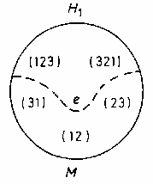
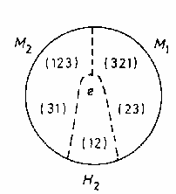
Theorem 2: Lagrange ( for finite groups )
H is a subgroup of G → Order(G) / Order(H) = n_{G} / n_{H} ∈ N
e | (123) | (132) | (23) | (13) | (12)
(123) | (132) | e | (12) | (23) | (13)
(132) | e | (123) | (13) | (12) | (23)
(23) | (13) | (12) | e | (123) | (132)
(13) | (12) | (23) | (132) | e | (123)
(12) | (23) | (13) | (123) | (132) | e
Examples: S₃
H₁ = { e, (123), (321) }. One coset:
M = (12) H₁ = (23) H₁ = (31) H₁
= { (12), (23), (31) }
H₂ = { e, (12) } . Two cosets:
M₁ = (23) H₂ = (321) H₂ = { (23), (321) }
M₂ = (31) H₂ = (123) H₂ = { (31), (123) }

Slide 23
Thm: H is an invariant subgroup → pH = Hp
Proof: H invariant → pHp^{–1} = H
Theorem 3. Factor / Quotient Group G/H
Let H be an invariant subgroup of G. Then
G/H ≡ { { pH | p ∈G }, • } with pH • qH ≡ (pq) H
is a (factor) group of G. Its order is n_{G} / n_{H}.
Example 1: C₄ = { e = a⁴, a, a², a³ }
H = { e, a² } is an invariant subgroup.
Coset M = a H = a² H = { a, a³ }.
Factor group C₄/H = { H, M } ≈ C₂
H | M
M | H

Slide 24
Example 2: S₃ = { e, (123), (132), (23), (13), (12) }
H = { e, (123), (132) } is invariant
Coset M = { (23), (13), (12) }
Factor group S₃ /H = { H, M } ≈ C₂
C_{3v} / C₃ ≈ C₂
e | (123) | (132) | (23) | (13) | (12)
(123) | (132) | e | (12) | (23) | (13)
(132) | e | (123) | (13) | (12) | (23)
(23) | (13) | (12) | e | (123) | (132)
(13) | (12) | (23) | (132) | e | (123)
(12) | (23) | (13) | (123) | (132) | e
Example 3: T^{d} ≡ Γ = { T(n), n∈ Z }
Γ_{m} = { T(mn), n∈ Z } is an invariant subgroup.
Cosets: T(k) Γ_{m} k = 1, …, m –1 & T(m) Γ_{m} = Γ_{m}
Products: T(k) Γ_{m} • T(j) Γ_{m} = T(k+j) Γ_{m}
Factor group: Γ / Γ_{m} = { { T(k) Γ_{m} | k = 1, …, m –1 }, • } ≈ C_{m}
Caution: Γ_{m} ≈ Γ

Slide 25
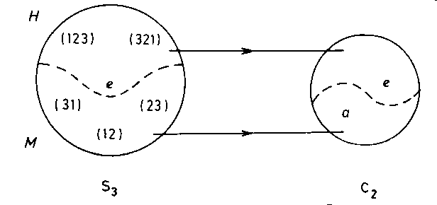
6 Homomorphisms
Definition 11: Homomorphism
G is homomorphic to G' ( G ~ G' ) if  a group structure preserving mapping from G to G', i.e.
 φ : G → G' g  g' = φ(g)
∋ a b = c  a' b' = c'
Isomomorphism: φ is invertible ( 1-1 onto ).
Example:
φ: S₃ → C₂
with φ(e) = φ[(123)] = φ[(321)] = e
φ[(23)] = φ[(31)] = φ[(12)] = a
is a homorphism S₃ ~ C₂.

Slide 26
Theorem 4:
Let φ: G → G' be a homomorphism and Kernel = K = { g | φ(g) = e' }
Then K is an invariant subgroup of G and G/K ≈ G'
Proof 1 ( K is a subgroup of G ):
φ is a homomorphism:
∴ a, b ∈ K → φ(ab) = φ(a) φ(b) = e' e' = e' → ab ∈ K (closure)
φ(ae) = φ(a) φ(e) = e' φ(e) = φ(e)
= φ(a) = e' → φ(e) = e' → e ∈ K (identity)
φ(a^{–1}a) = φ(a^{–1} ) φ( a) = φ(a^{–1} ) e' = φ(a^{–1} )
= φ(e) = e' → a^{–1} ∈ K (inverse)
Associativity is automatic. QED

Slide 27
Proof 2 ( K is a invariant ):
Let a ∈ K & g ∈ G.
φ( g a g^{–1} ) = φ(g) φ(a) φ( g^{–1}) = φ(g) φ( g^{–1}) = φ(g g^{–1}) = φ(e) = e'
→ g a g^{–1} ∈ K
Proof 3 ( G/K ≈ G' ):
G/K = { pK | p ∈G }
∴ φ( pa ) = φ( p ) φ( a ) = φ( p ) e' = φ( p ) ∀ a ∈ K
i.e., φ maps the entire coset pK to one element φ( p ) in G'.
Hence, ψ : G/K → G' with ψ( pK ) = φ( p ) = φ( q∈ pK ) is 1-1 onto.
ψ( pK qK ) = ψ[ (pq)K ] = φ( pq ) = φ( p) φ( q) = ψ( pK) ψ(qK )
→ ψ is a homomorphism. QED

Slide 28
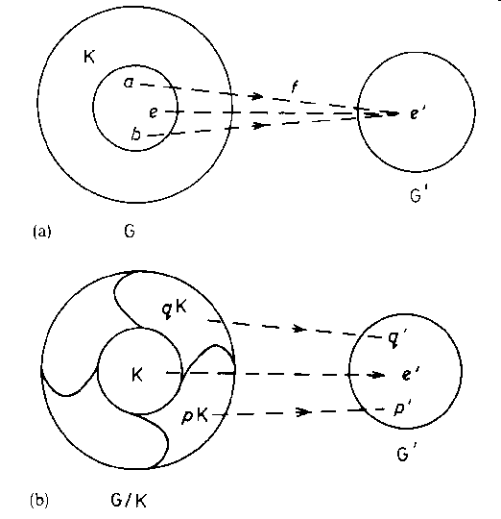
Kernel
G/K ≈ G'

Slide 29
7 Direct Products
Definition 12: Direct Product Group A ⊗ B
Let A & B be subgroups of group G such that
a b = b a ∀ a ∈ A & b ∈ B
∀ g ∈ G,  a ∈ A & b ∈ B ∋ g = a b = b a
Then G is the direct product of A & B, i.e, G = A ⊗ B = B ⊗ A
Example 1: C₆ = { e = a⁶, a, a², a³, a⁴, a⁵ }
Let A = { e, a³ } & B = { e, a², a⁴ }
a b = b a trivial since C₆ is Abelian
e = e e, a = a³ a⁴, a² = e a², a³ = a³ e, a⁴ = e a⁴, a⁵ = a³ a²
∴ C₆ = A ⊗ B ≈ C₂ ⊗ C₃

Slide 30
Example 2: O(3) = R(3) ⊗ { e, I_{S} }
Theorem 5:
G = A ⊗ B →
A & B are invariant subgroups of G
G/A ≈ B, G/B ≈ A
Proof:
g = a b → g a' g^{–1} = a b a' b^{–1} a^{–1} = a a' b b^{–1} a^{–1} = a a' a^{–1} ∈ A
A is invariant ; dido B.
G = { a B | a ∈ A } → G/B ≈ A & similarly for B
Caution: G/B ≈ A does not imply G = A ⊗ B
Example: S₃
H = { e, {123}, {321} } is invariant. Let H_{i} = { e, (j k) } ( i,j,k cyclic )
Then S₃/H ≈ H_{i} but S₃ ≠ H ⊗ H_{i}

